Slide 1
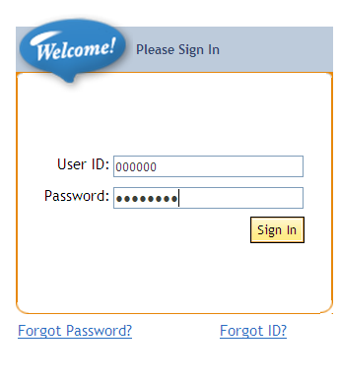
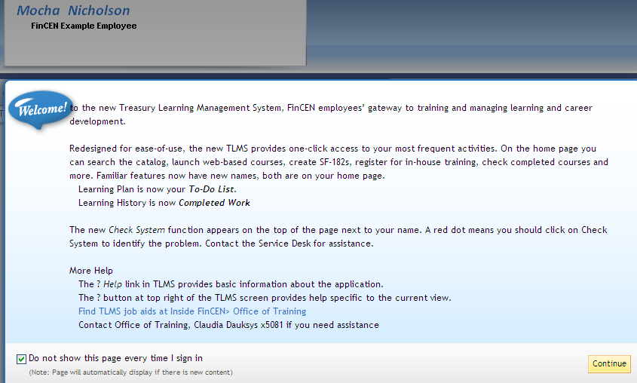
Upgraded TLMS
Login
Key Information
Login same as before.
Learning Plan is now To-Do List.
Learning History is now Completed Work
(still Learning History on Reports menu).
Click on Home if you get lost.
Personal information or supervisor wrong? It must be corrected in HR Connect—not TLMS.
TLMS login ID is same as before--6 digits for most people.
Same password as you used in old TLMS system.
You can retrieve your own password/ID if you have a security question and answer in TLMS. You can also change your security question/ answer. See page 3.
1
1
2
2
News Page
The News Page appears after login.
At lower left you may check “Do not show page every time I sign in” (News Page will still appear after login if TLMS has new information for you).
Click Continue at lower right.
3
4
3
4
Page 1

Slide 2
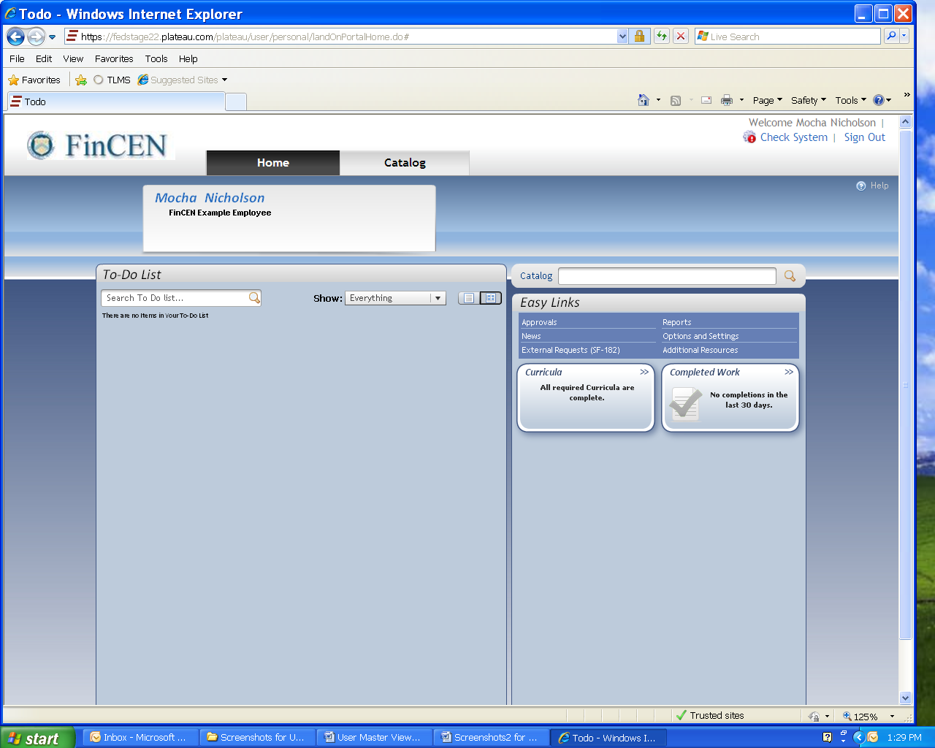
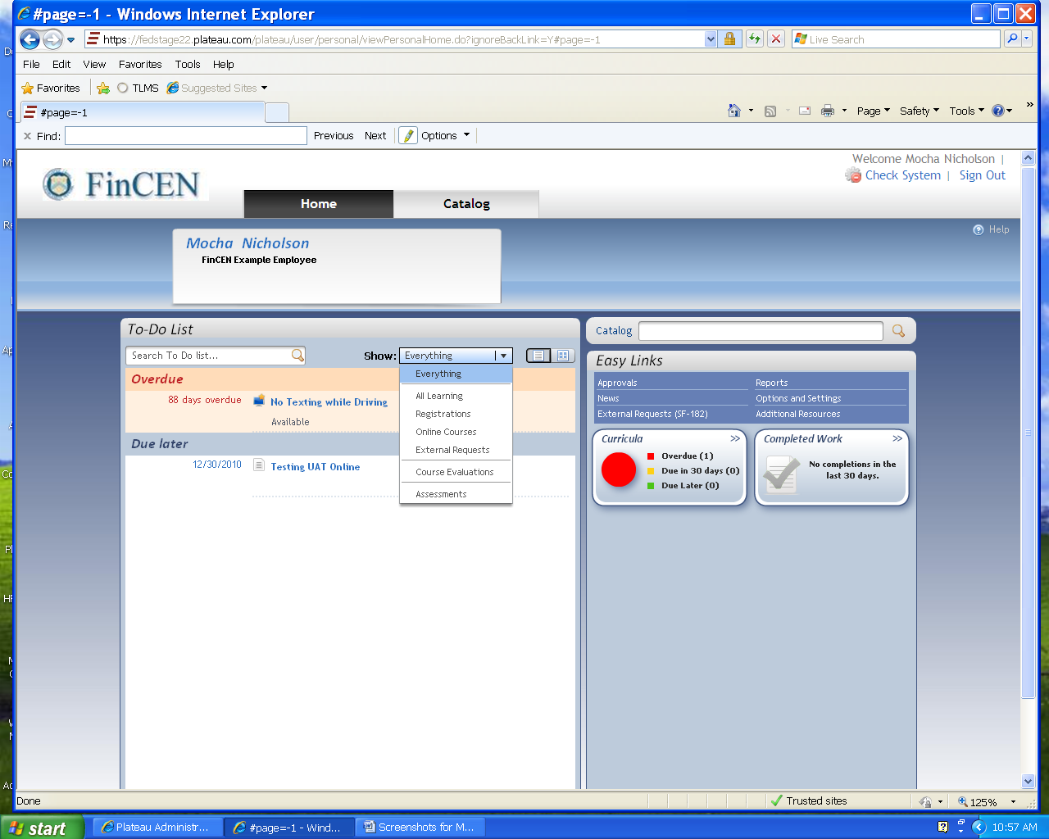
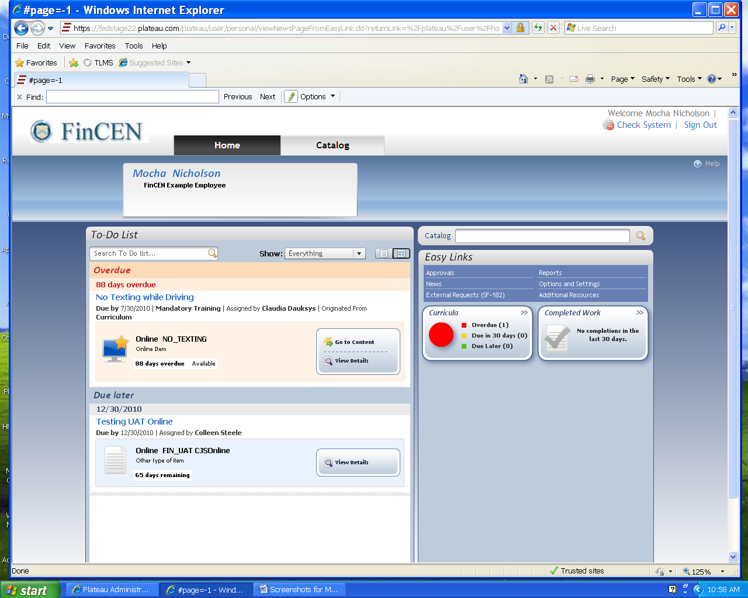
Home Page
5
7
6
7
8
9
6
The Home page appears after you click Continue on News Page
To-Do List replaces Learning Plan (prior TLMS) and will initially be blank. As you register for in-house events, have (new) approved SF-182s, training is assigned to you or you begin on-line courses, they will appear on your To-Do List.
Select Catalog to search.
Easy Links replace menu and submenu options in prior TLMS version.
Completed Work replaces Learning History in prior TLMS system.
Click on Home whenever you want to return to this page.
5
6
6
Notice how the same two sample items display in each view.
Remember your
To-Do List will initially be blank.
7
8
9
5
Page 2

Slide 3
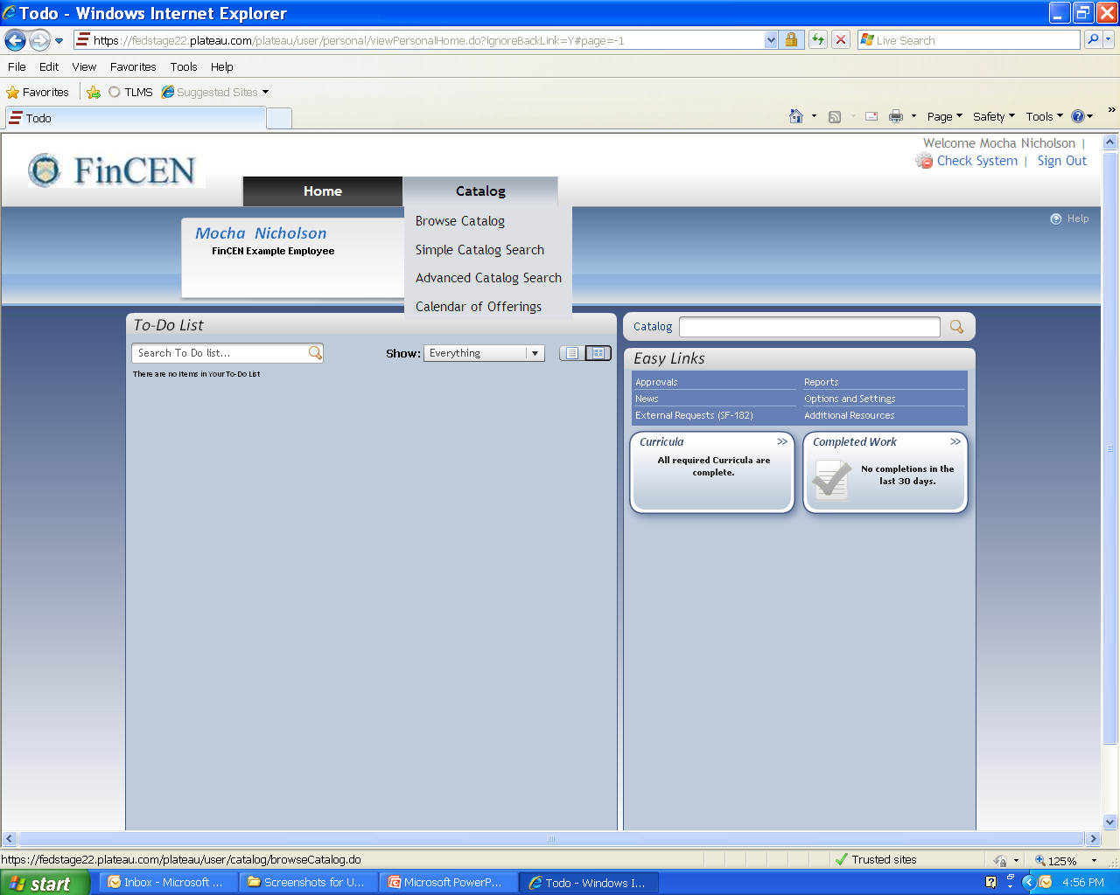
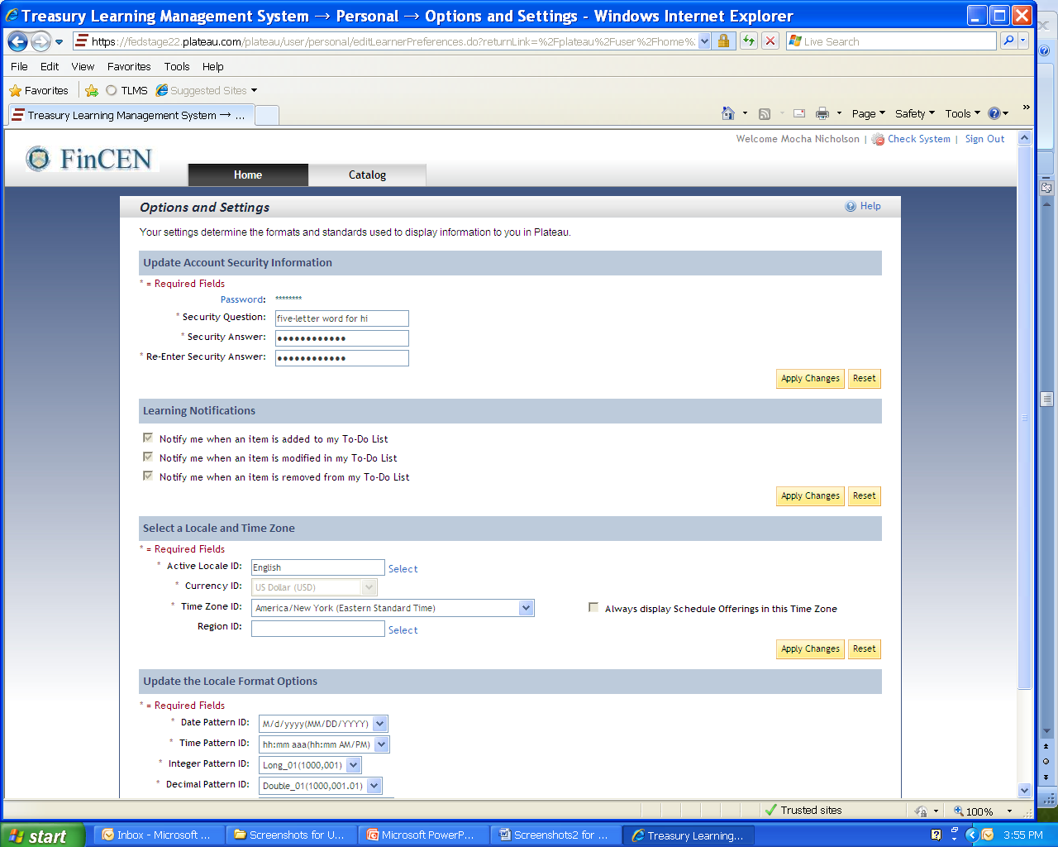
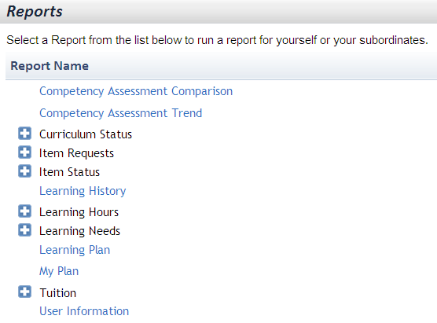
Search & Easy Links
Search catalog here
or here.
(News Page)
This is where you create/change your security question & answer: required for TLMS to unlock you (See 1st page: Forgot ID? Forgot Password?)
Grayed-out response boxes on this page indicate global settings that you cannot change.
Some reports are not relevant to FinCEN (such as Competency Assessment or My Plan) so no report results will appear.
Page 3

Slide 4
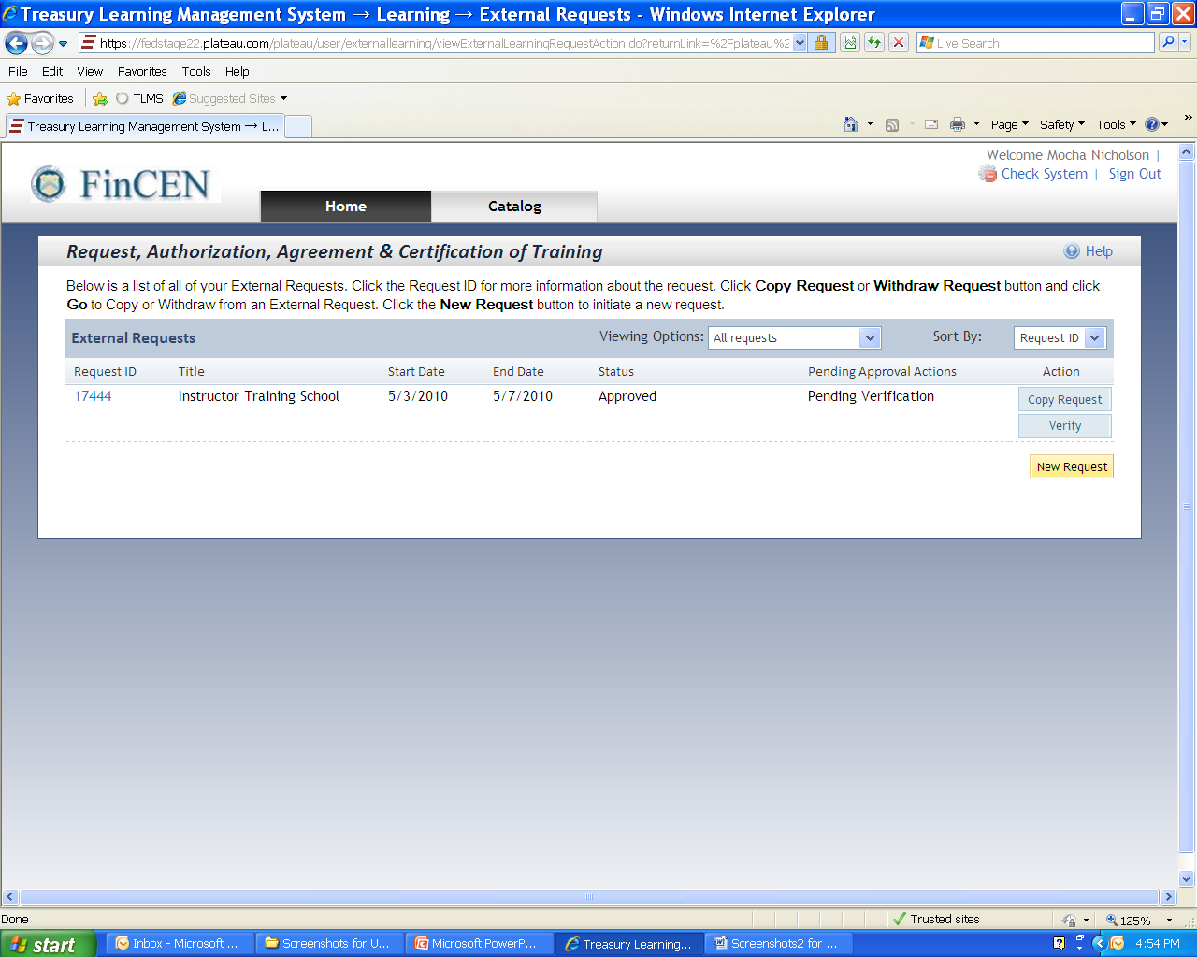
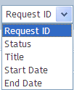
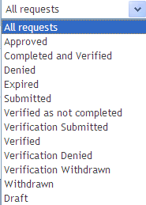
SF-182
Page 4

Slide 5
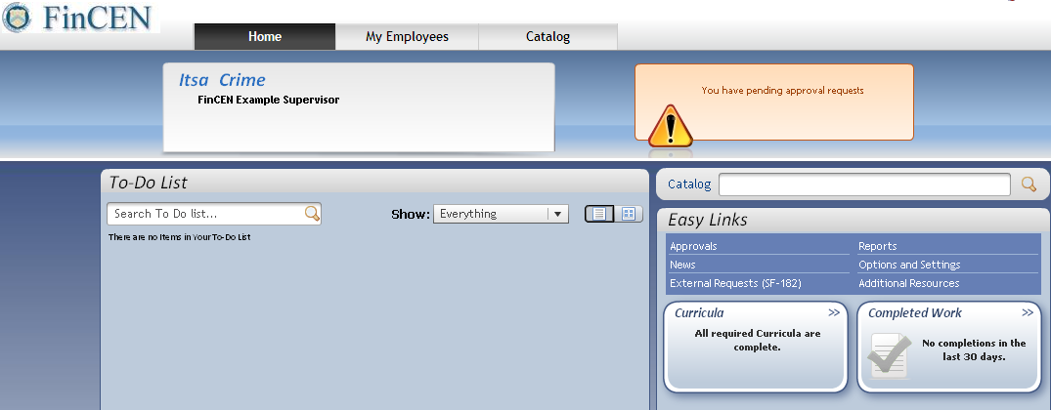
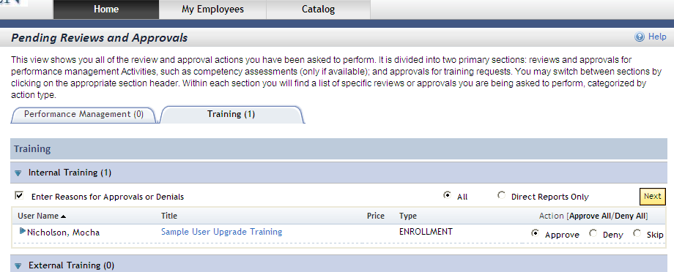
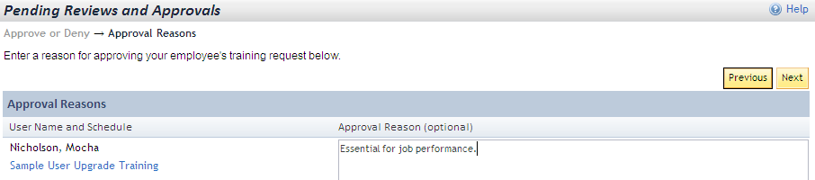
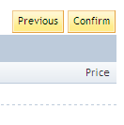
Approving
10
11
Mocha Nicholson registered for an in-house class (1st-line supervisor approval required).
Itsa Crime, (her supervisor or whoever is listed as approver) then had this message on her Home Page.
Itsa clicked on Approvals.
Approved & hit Next.
Entered the reason
(reason is mandatory for deny).
Confirmed the transaction
11
10
11
12
13
12
14
14
13
Page 5

Slide 6
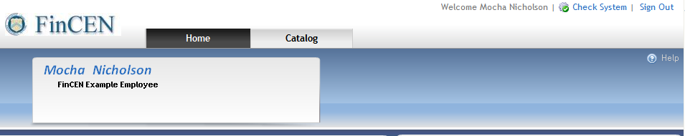
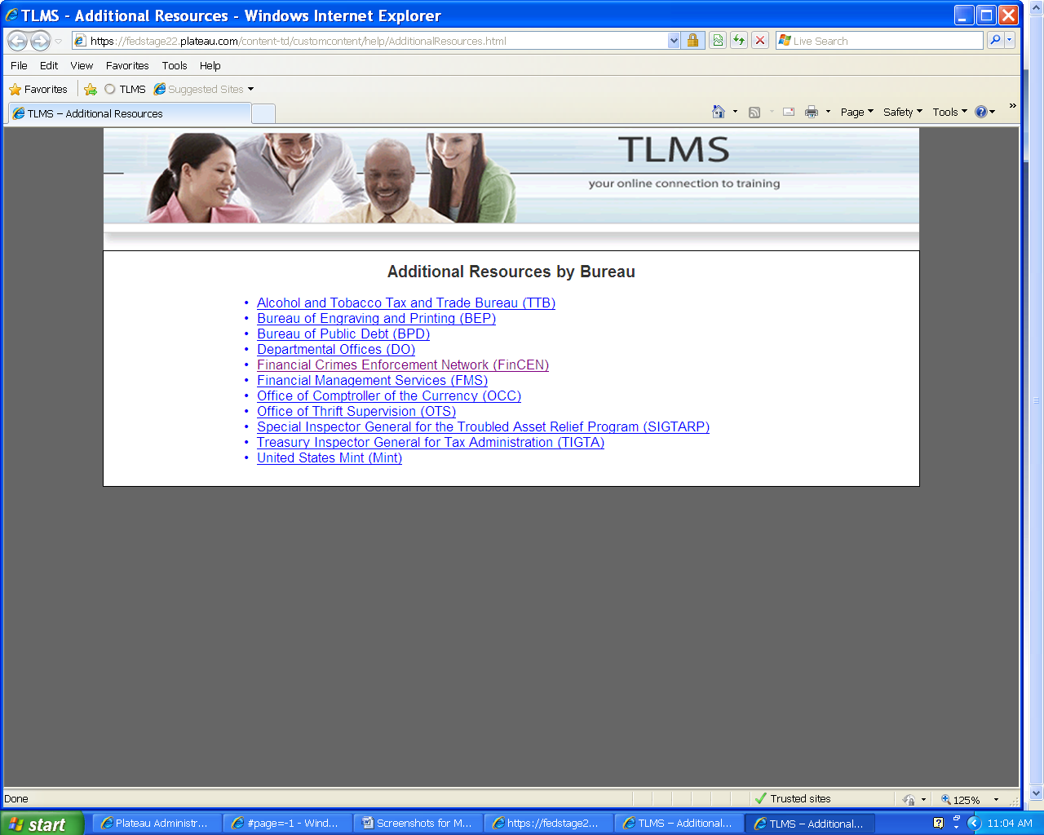
Additional Resources
Help at the top of the page has information about all of TLMS
Help in the work area is specific to the topic (in this example, Request, Authorize, Agreement… Training).
Page 6

