Slide 1
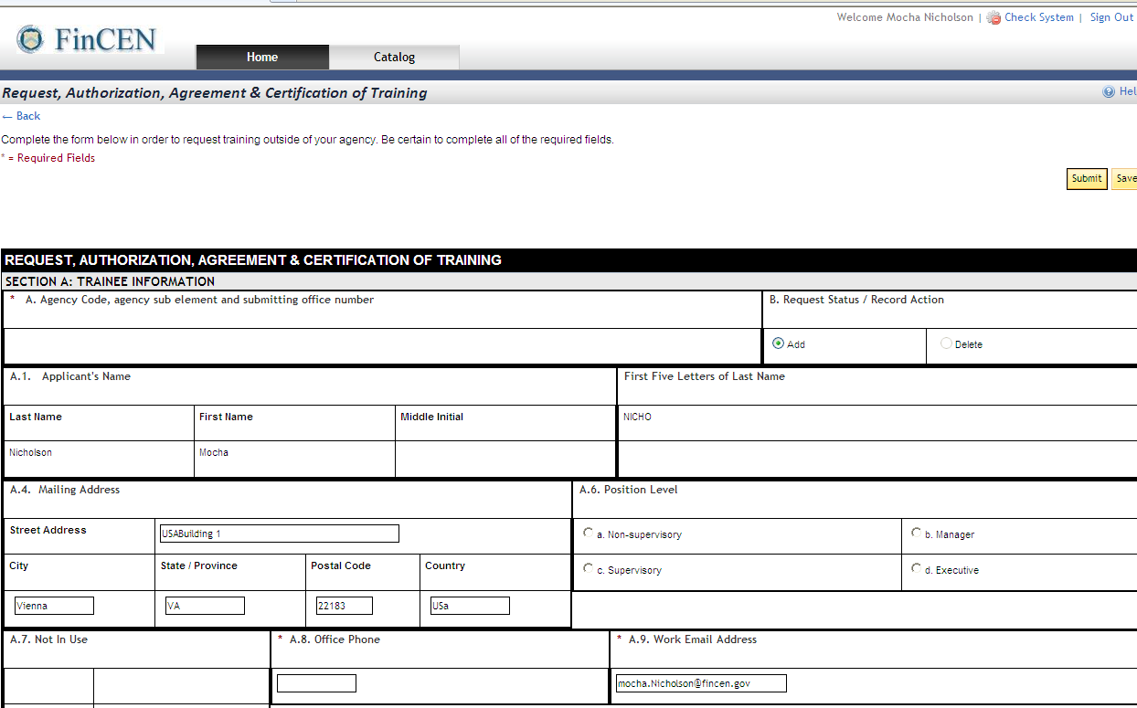
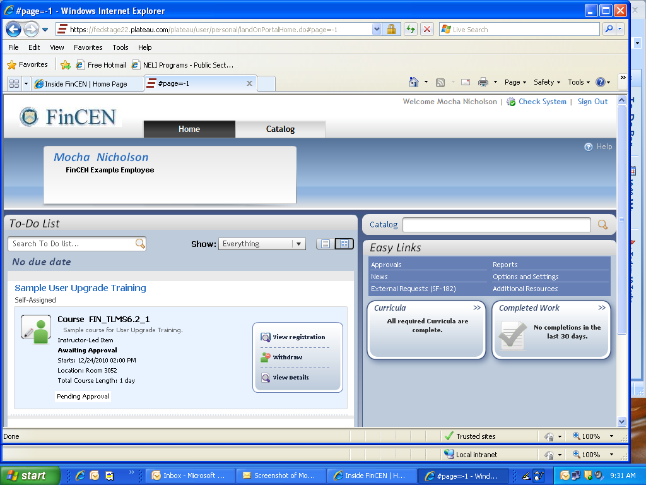
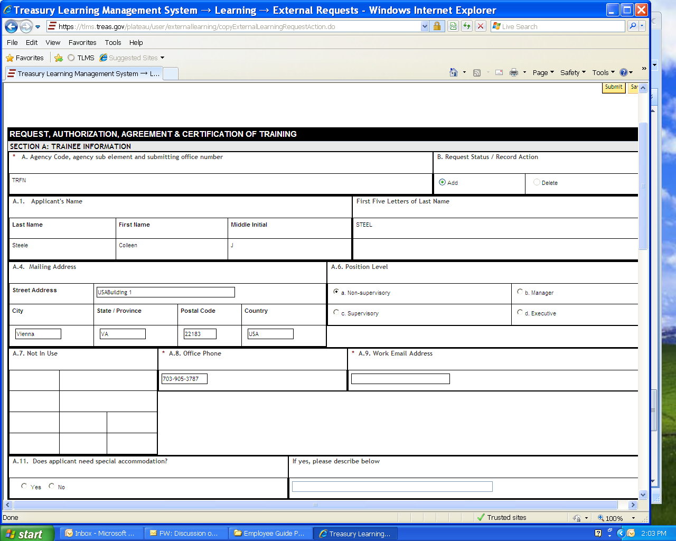
Create an SF-182
3-3-2011
Before you begin: 1. Gather all your course /conference information. (vendor, event name & dates, location, cost, etc.).
2. Calculate travel costs (check airfare, per diem, etc). OPM requires this information on the SF-182.
However, you must still complete a travel request; training does not have a role in travel arrangements.
You must complete required fields (*) to submit.
indicates fields TLMS will automatically fill according to your HR Connect information.
A
TRFN
A
A
A
A
Easily overlooked but required field —manually enter.
A
Page 1

Slide 2
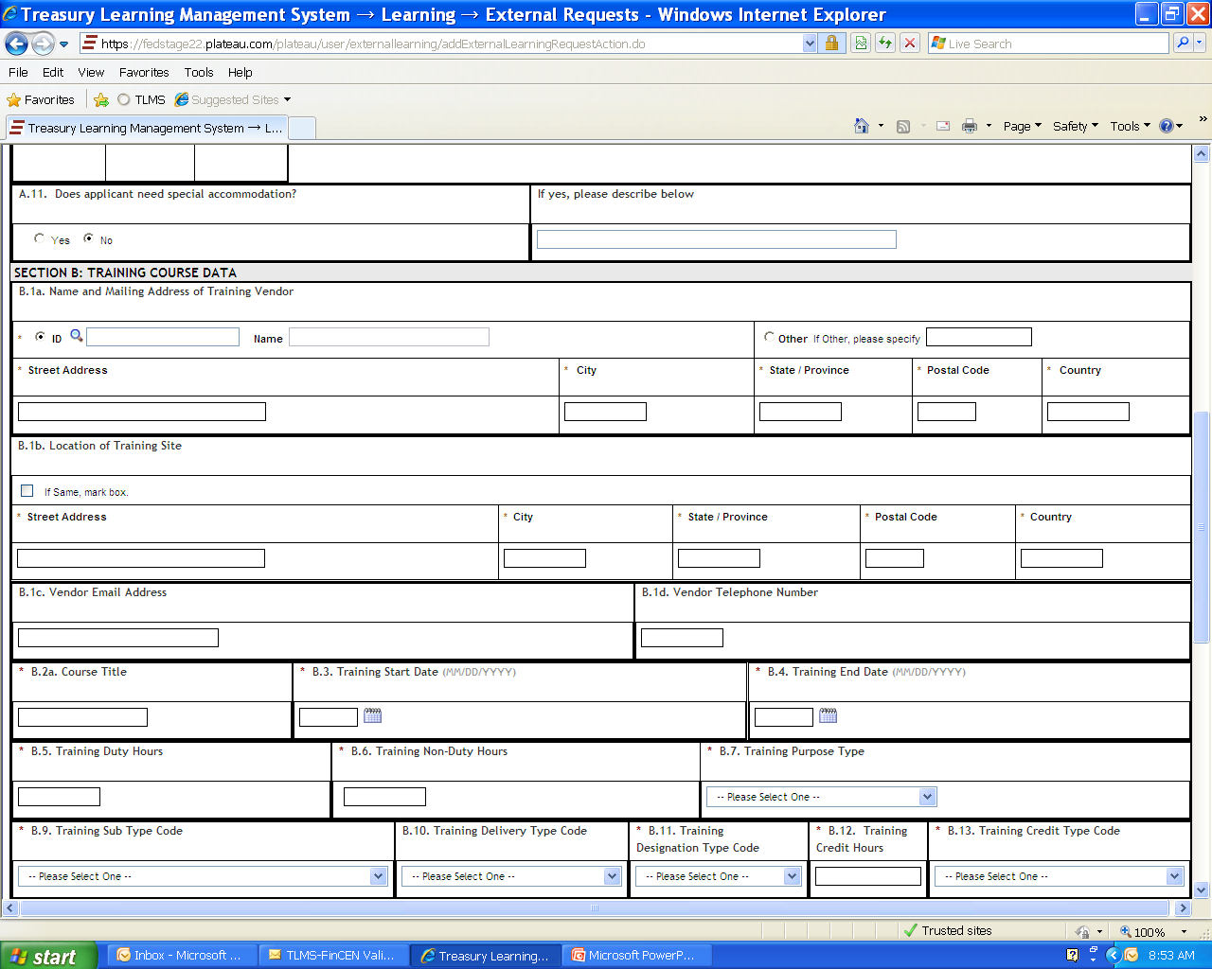
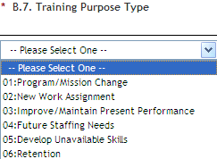
1 full day = 7 hours.
B.1a
Search for vendor by clicking on , if vendor is listed--system will autofill address.
OR
If vendor is not listed, select Other and enter vendor’s name in box. Also enter vendor’s address.
B.5
Calculate Training Hours at 7 per each full day. Training is never 8 hours/day due to lunch, breaks.
Page 2

Slide 3
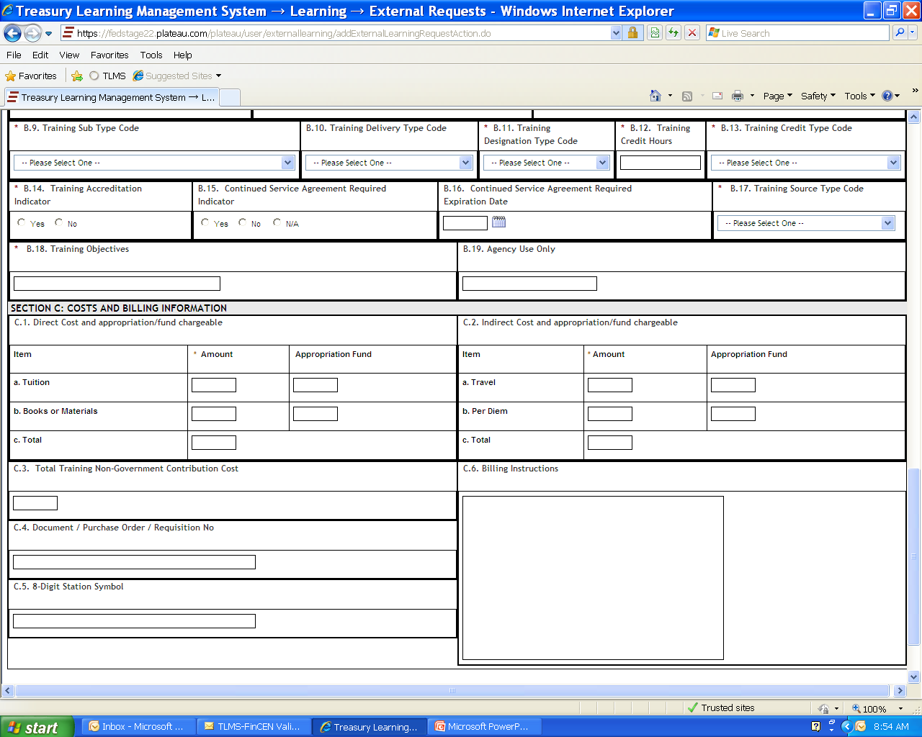
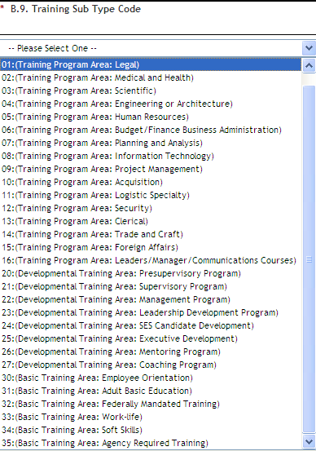
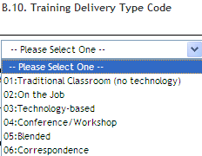
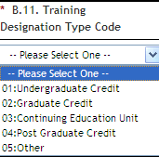
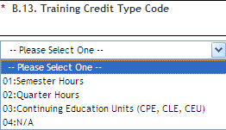
Use the drop boxes to complete B.9 – B.13
B.12
Enter 0
Other
options are
irrelevant
to FinCEN
B.13
Select 04:N/A
Other options are
irrelevant to FinCEN
B.10
This will usually be 01:Traditional Classroom (course delivered in person)
OR
04 Conference/ Workshop.
B.11
Select 05:Other
Other options are irrelevant to FinCEN
B.9
Select the best match from OPM’s options.
07 is best choice for analyst’s training.
Don’t use 14 – it’s for building trades.
Page 3

Slide 4
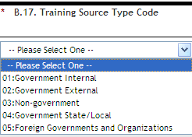
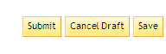
Skip this box
B.18 Explain why YOU are taking the class.
Do NOT insert the course description.
You must list costs.
(course/conference cost)
0
Skip this -- Office of Training inserts the PO number.
Please list here registration information, contacts, event URL and/or any relevant membership number for discount.
Do not enter any billing instructions.
Skip this box
Costs
C.1 Books or Materials cost should always be 0. Any materials not included in course cost need to be requested using PRISM or GovTrip.
C.2 Travel costs should be carefully calculated and based on actual per diem, airfare, lodging and other applicable rates.
Page 4

Slide 5
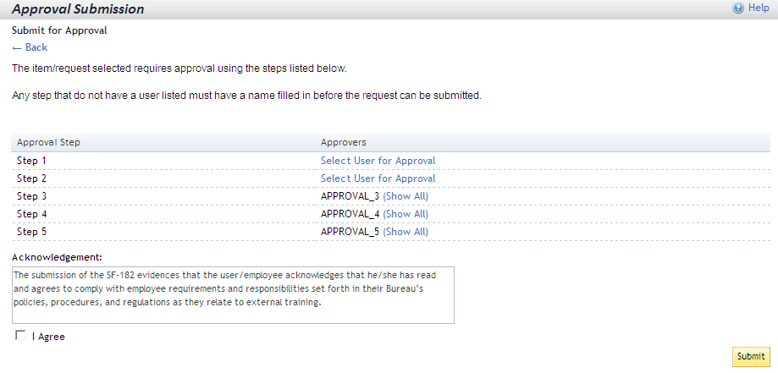
Your approvers are:
Step 1 Your 1st line supervisor (or team leader or other approver designated by your1st line supervisor).
Step 2 ALWAYS your 2nd line supervisor (must be Associate Director or equivalent—unless he/she directed otherwise).
Do not get creative here--your 1st line supervisor (Assistant Director) is NOT the Step 2 Approver.
You enter 1st and 2nd-line approvers.
See next page to select approvers.
TLMS Autofills steps 3-5 with appropriate
Office of Training approvers.
You cannot submit if you don’t agree.
Page 5

Slide 6
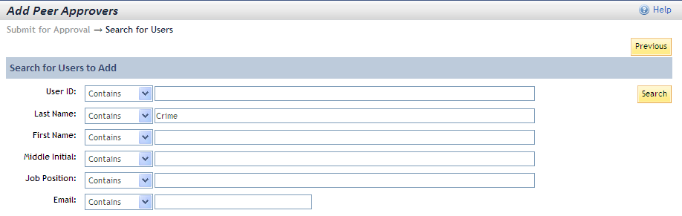
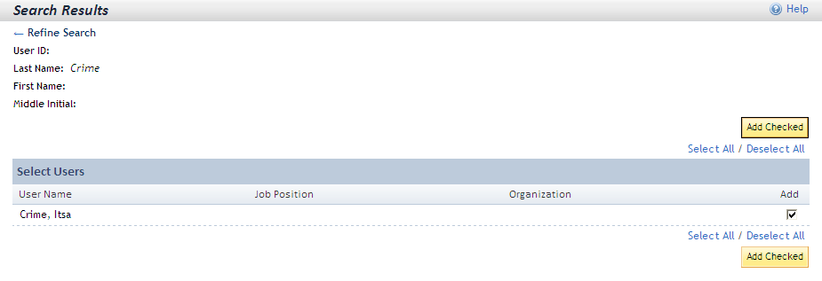
(Says Peer but must be your 1st & 2nd line supervisors.)
1
Enter search criteria: first and/or last name only.
Spelling must be correct or your search won’t work.
2
james.murphy@fincen.gov
Or if Jim Murphy is your supervisor, enter only his email address as your search criteria--not his name.
There is another James F. Murphy in Treasury and you’re likely to select the wrong one.
Search results wrong? Use Refine Search and enter new criteria.
4
3
Page 6

Slide 7
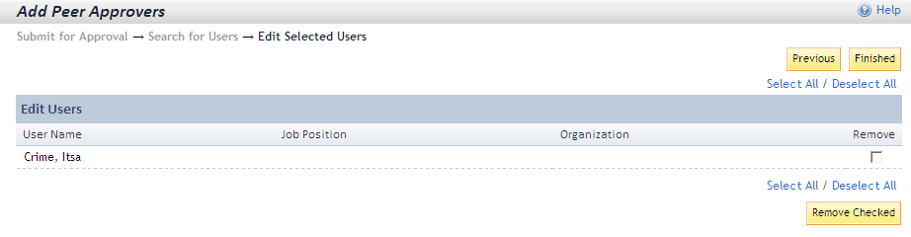


5
After selecting “add checked” (previous page), TLMS asks you to confirm your action by clicking Finished.
Use this option if needed.
6
7
Shows you inserted 1st approver. Click on Show All to see the name you inserted. In this example, Itsa Crime was inserted.
6
Click on Select User for Approval to repeat the search and selection process to enter 2nd line supervisor.
7
Page 7

Slide 8

Notice Step 1 & 2 approvers are inserted.
8
9
You can check the approval status of your SF-182 in TLMS anytime.
You are responsible for ensuring your 1st and 2nd-line approvers complete their actions.
Office of Training takes over after step 1 and step 2 approvers complete their actions.
Page 8

